Slide 1
Parallel TCP
Weice Sun, Zhongyi LUO, Siyuan Peng, Mengying Du, Qiang Wang

Slide 2
What is Parallel TCP?
Data set is divided into a number of smaller chunks, and each component chunk is transmitted using its own TCP session.

Slide 3
Project Objective
Parallel TCP Real Implementation
NS 3 Simulation
Data Analysis

Slide 4
Parallel TCP Real Implementation
Design Principles
Coding Methods
Testing
Data Analysis

Slide 5
(*Pseudo Code or Flow Chart)

Slide 6

Test Results
Exactly the same!
Data Transferred via Parallel TCP

Slide 7
Data Analysis
Is there a trend?
What this implies?
What we do next?

Slide 8
Parallel TCP fairness ---ns3 simulation
Topology:
Simulation Environment:
OSX 10.10.5 2.9 GHz Intel Core i5
ns-3.24.1
Global parameter setting:
Random seed: RngSeedManager::SetSeed(11223344)
Protocol TCP Reno
Segment Size = 512
BW and delay: 5Mbps 10ms & 1Mbps 20ms
Sender
Sink

Slide 9
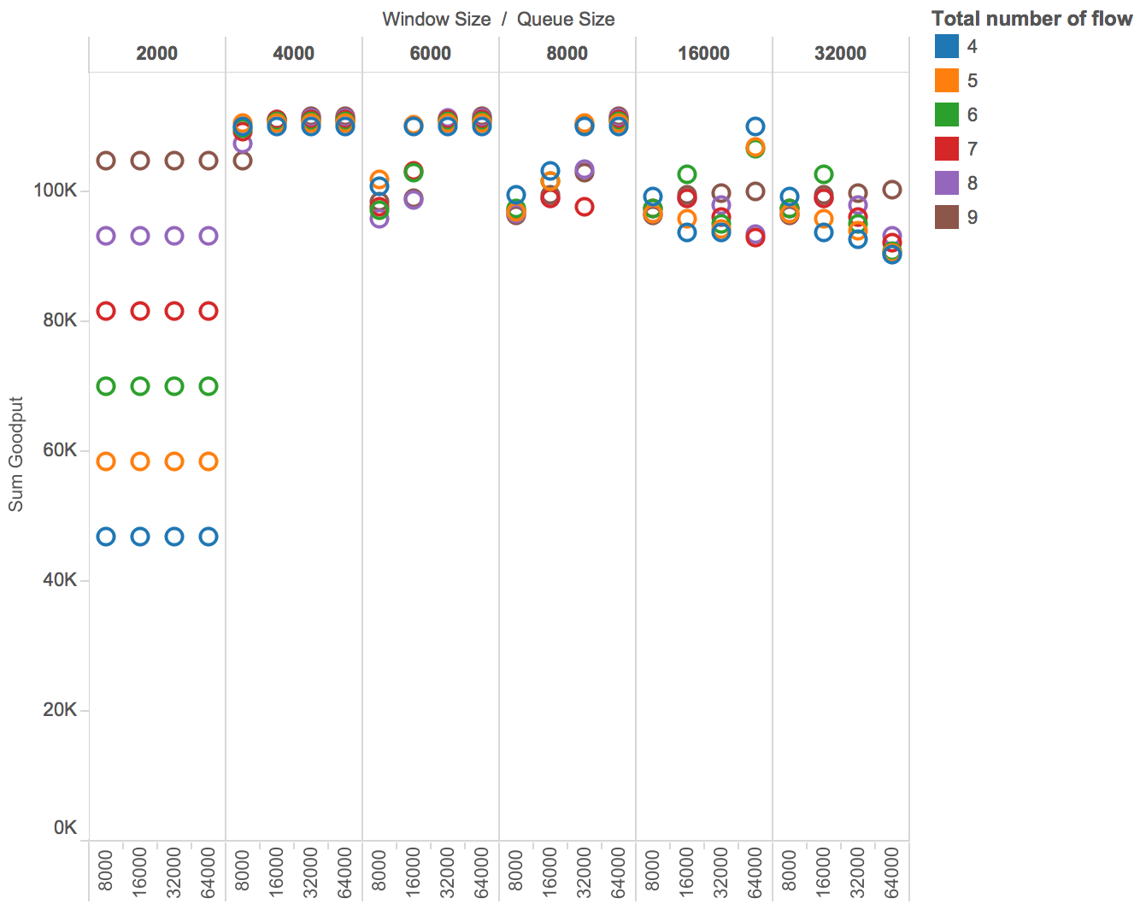
Parallel TCP throughput -- simulation result
Queuing Mode
DropTail Queue
+- 15%
{2000 Bytes
- 32000 Bytes}
Window Size
{8000 Bytes
- 64000 Bytes}
Queue Size
Port Number
{4 - 9}

Slide 10
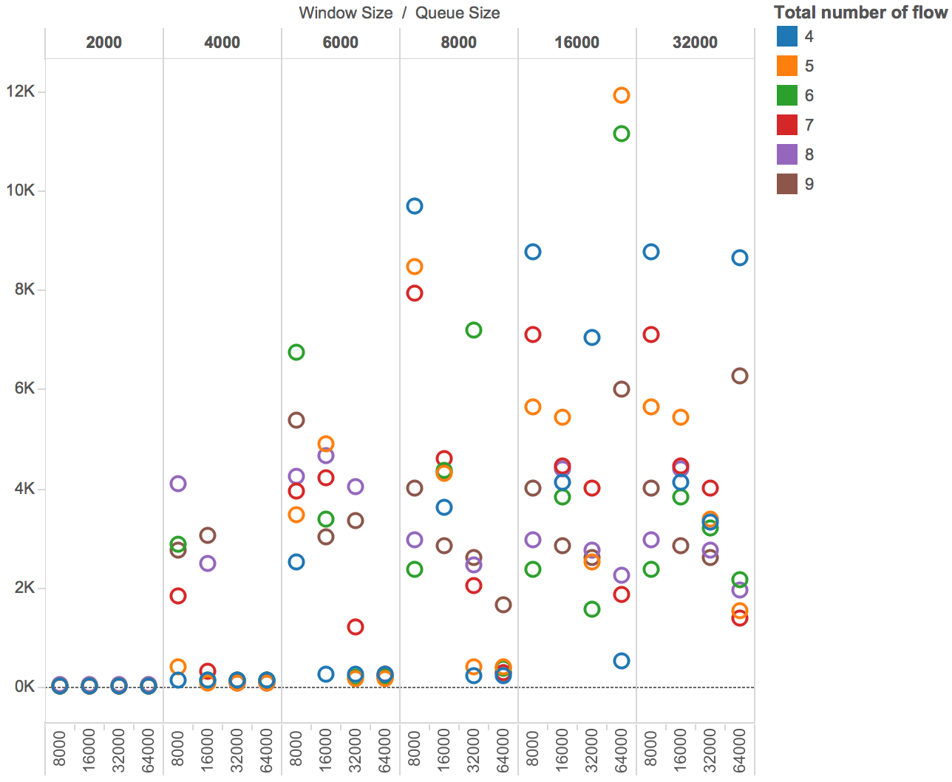
Parallel TCP standard deviation -- simulation result
Queuing Mode
DropTail Queue
Port # 4-6
{2000 Bytes
- 32000 Bytes}
Window Size
{8000 Bytes
- 64000 Bytes}
Queue Size
Port Number
{4 - 9}
Max Thresh: 0.24 * QueueSize;
Min Thresh: 0.04 * QueueSize;
Better fairness

Slide 11
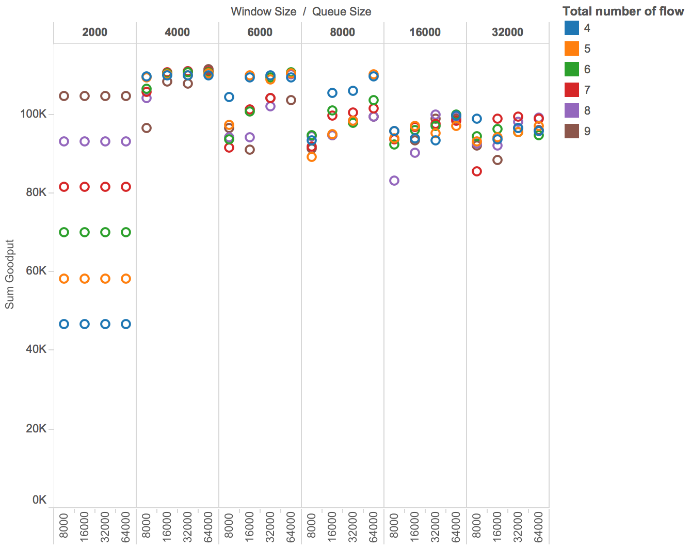
Parallel TCP throughput -- simulation result
Queuing Mode
RED
Queue
+- 10%
{2000 Bytes
- 32000 Bytes}
Window Size
{8000 Bytes
- 64000 Bytes}
Queue Size
Port Number
{4 - 9}
Max Thresh: 0.24 * QueueSize;
Min Thresh: 0.04 * QueueSize;

Slide 12
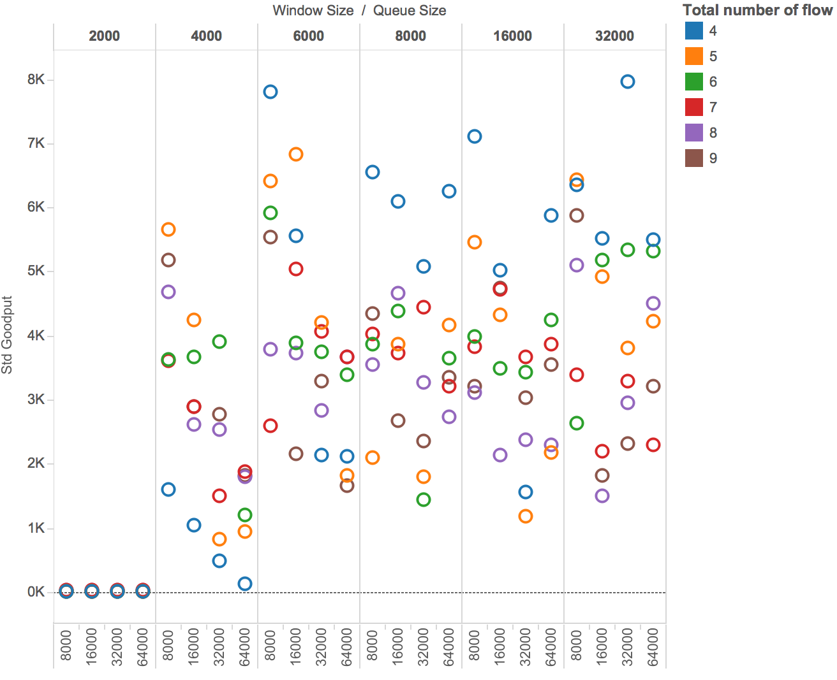
Parallel TCP standard deviation -- simulation result
Queuing Mode
RED
Queue
Port # 4-5
{2000 Bytes
- 32000 Bytes}
Window Size
{8000 Bytes
- 64000 Bytes}
Queue Size
Port Number
{4 - 9}
Max Thresh: 0.24 * QueueSize;
Min Thresh: 0.04 * QueueSize;
Better fairness

Slide 13
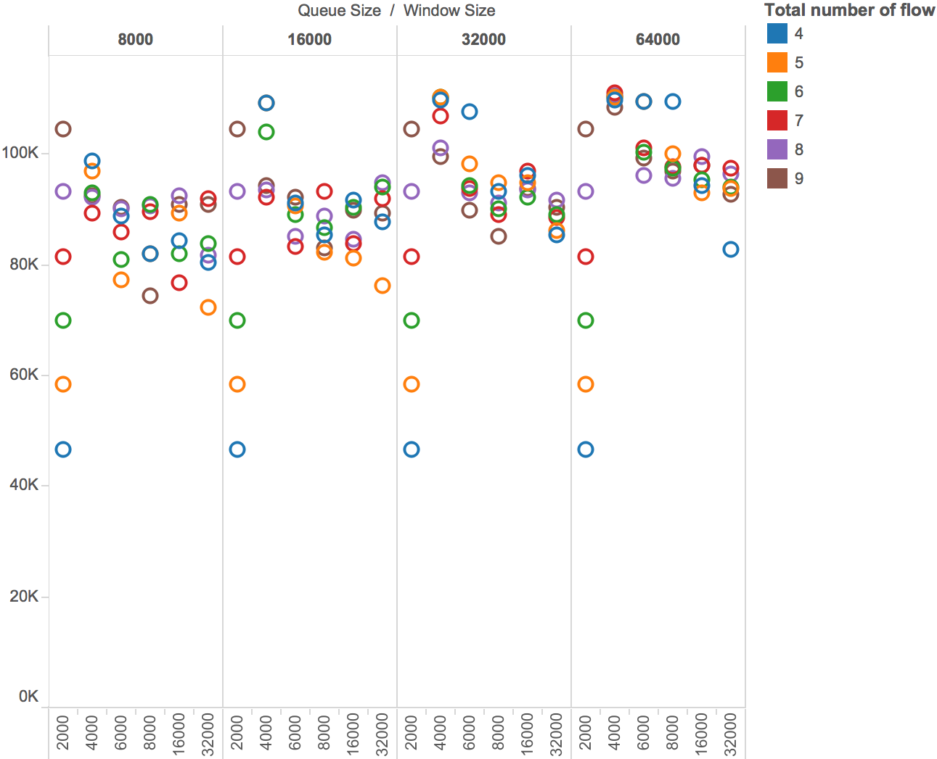
Parallel TCP throughput -- simulation result
Queuing Mode
RED
Queue
{2000 Bytes
- 32000 Bytes}
Window Size
+- 18%
{8000 Bytes
- 64000 Bytes}
Queue Size
Port Number
{4 - 9}
Max Thresh: 0.1 * QueueSize;
Min Thresh: 0.04 * QueueSize;

Slide 14
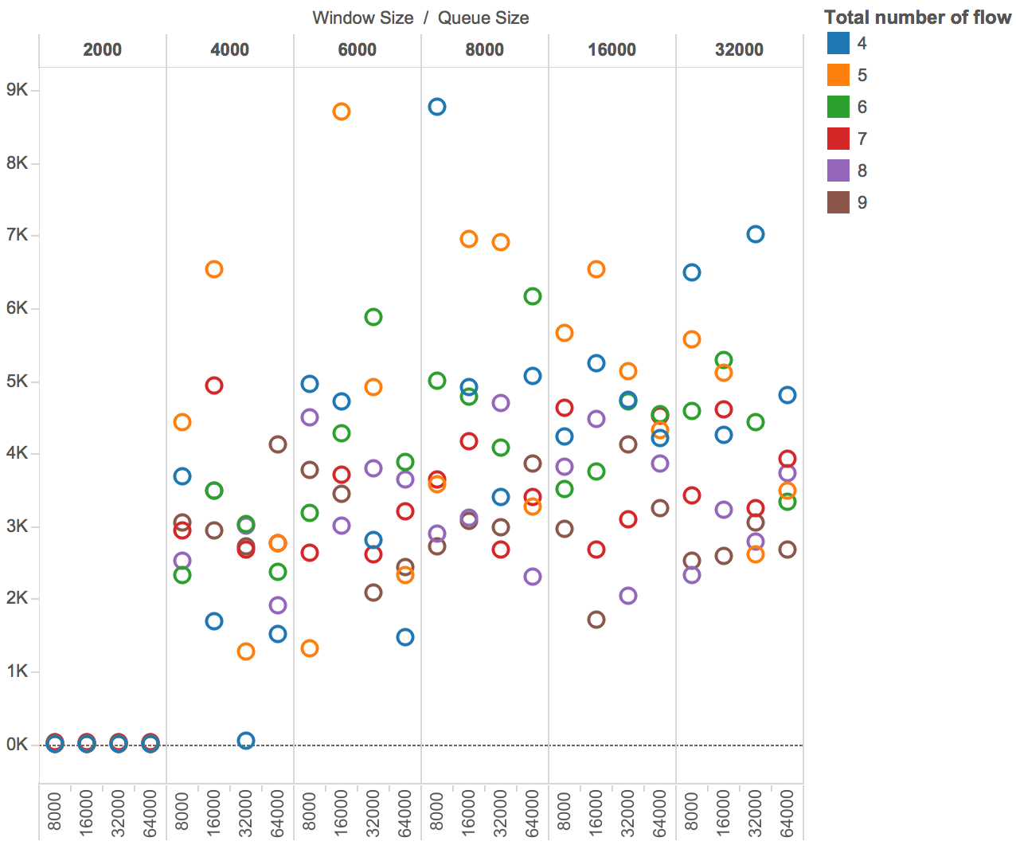
Parallel TCP standard deviation -- simulation result
Queuing Mode
RED
Queue
Port # 4-6
{2000 Bytes
- 32000 Bytes}
Window Size
{8000 Bytes
- 64000 Bytes}
Queue Size
Port Number
{4 - 9}
Max Thresh: 0.1 * QueueSize;
Min Thresh: 0.04 * QueueSize;
Better fairness

Slide 15
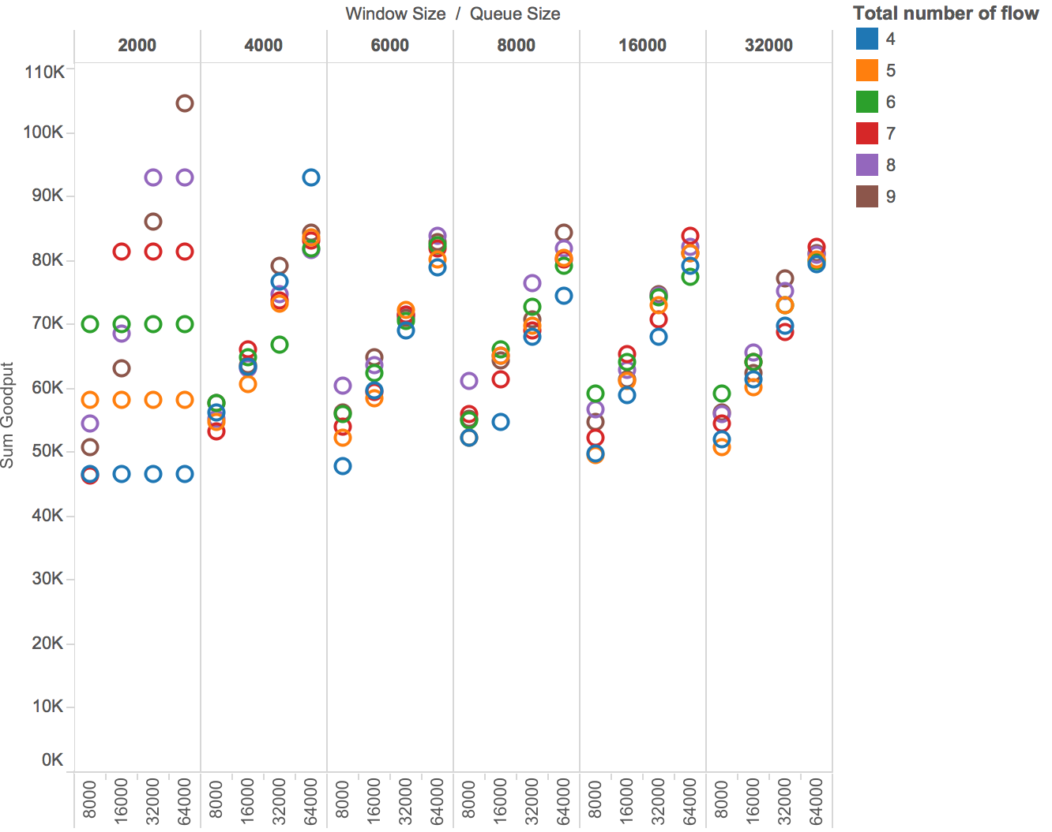
Parallel TCP throughput -- simulation result
Queuing Mode
RED
Queue
{2000 Bytes
- 32000 Bytes}
Window Size
{8000 Bytes
- 64000 Bytes}
Queue Size
+- 22%
Port Number
{4 - 9}
Max Thresh: 0.004 * QueueSize;
Min Thresh: 0.0001 * QueueSize;

Slide 16
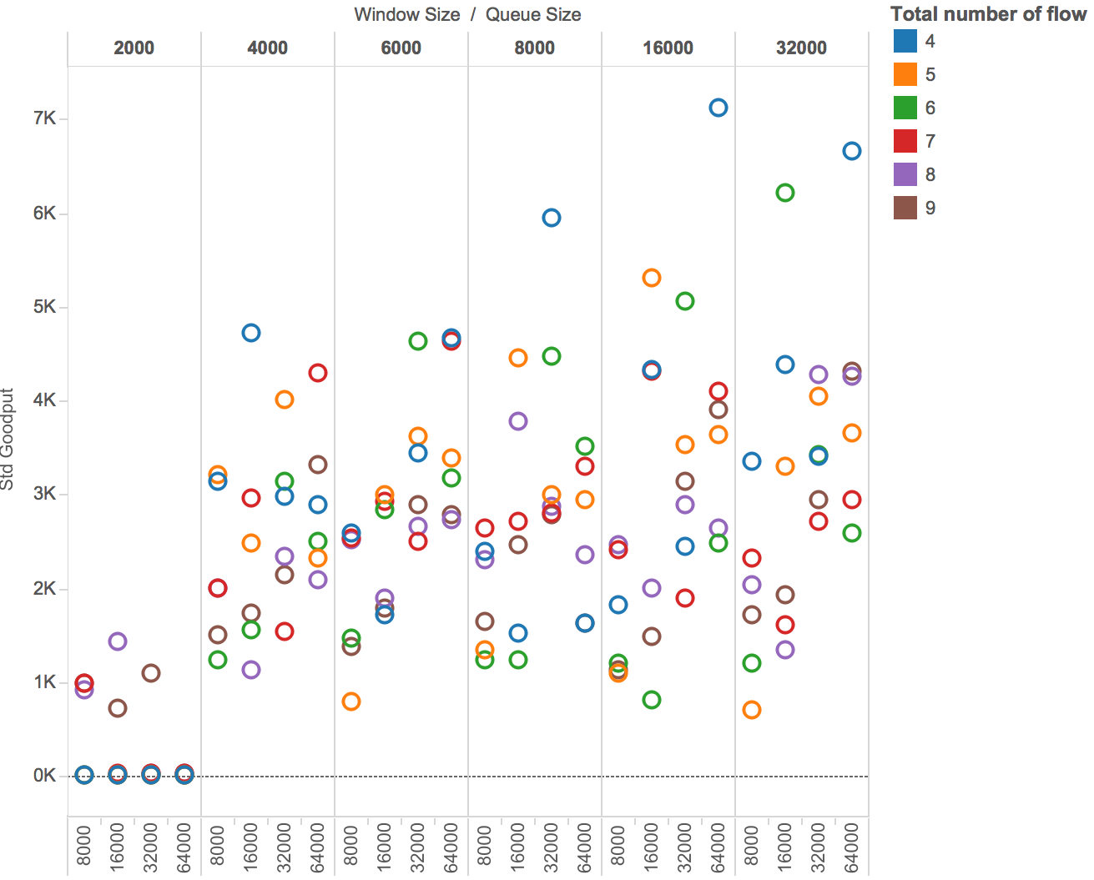
Parallel TCP standard deviation -- simulation result
Queuing Mode
RED
Queue
Port # 4-6
{2000 Bytes
- 32000 Bytes}
Window Size
{8000 Bytes
- 64000 Bytes}
Queue Size
Port Number
{4 - 9}
Max Thresh: 0.004 * QueueSize;
Min Thresh: 0.0001 * QueueSize;
Better fairness

Slide 17
ns3 simulation conclusion:
In terms of throughput:
Window Size + Queue Size
Port number
Drop Tail or RED (Threshold setting)
In terms of standard deviation:
Window Size + Queue Size
Port number
Drop Tail or RED (Threshold setting)

Slide 18
Conclusion

Slide 19
Q&A

